Slide 1
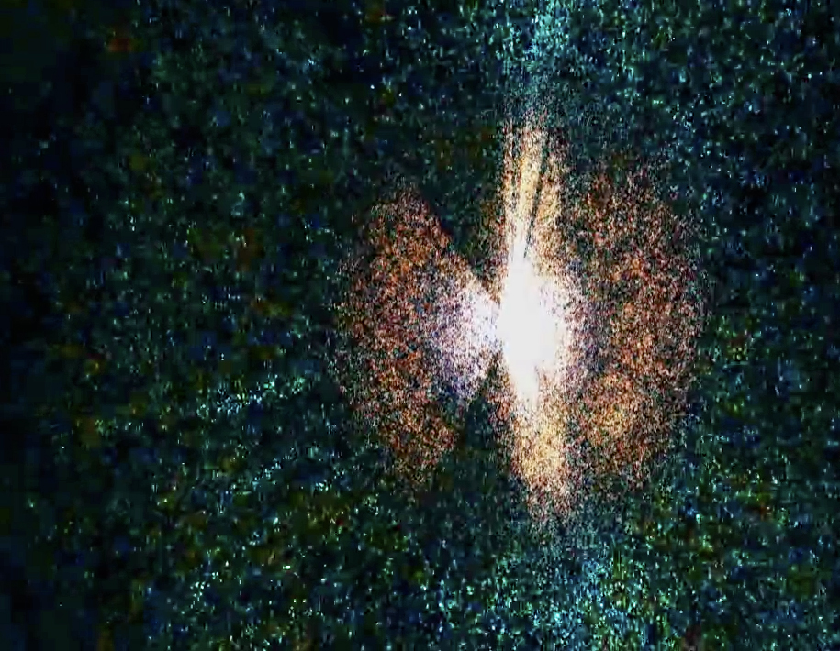
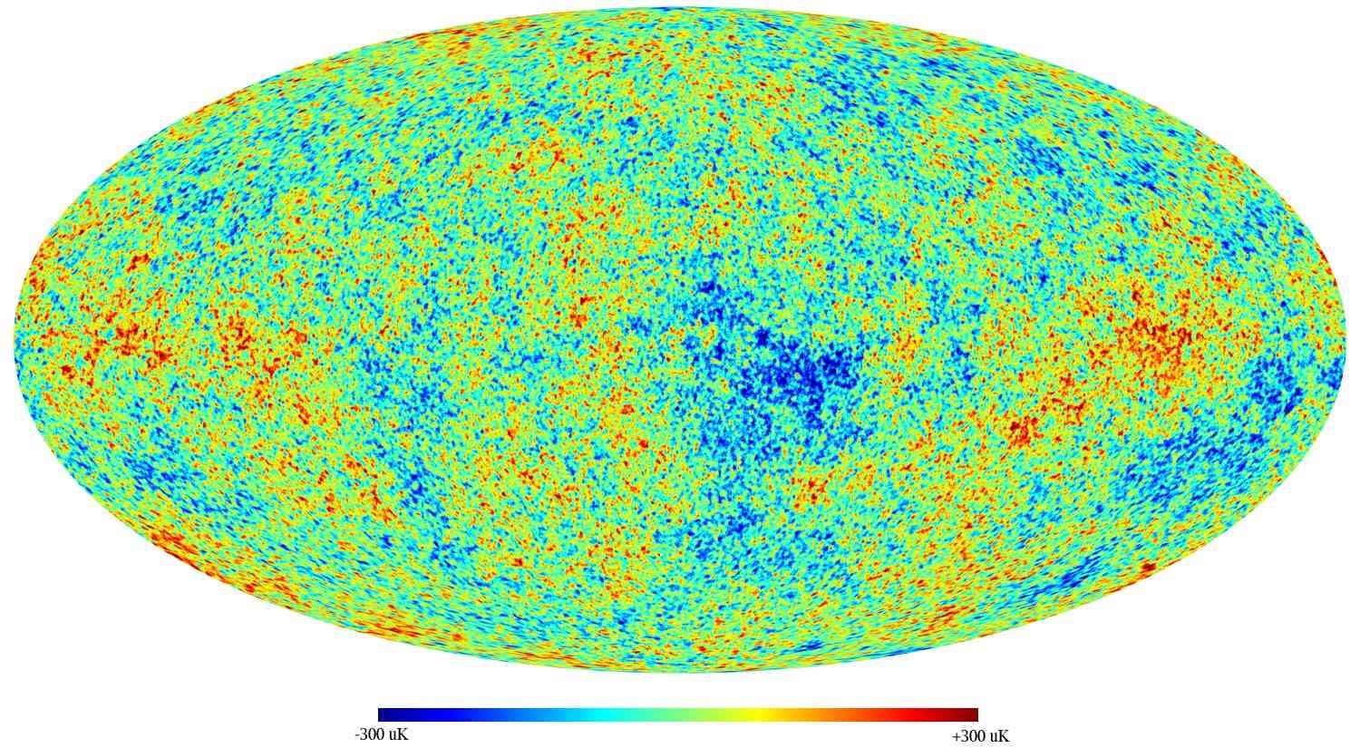
Cosmology and
Cosmic Acceleration
Energetic Cosmos Laboratory
Nazarbayev University, October 2016
Eric Linder
UC Berkeley & Berkeley Lab Energetic Cosmos Laboratory

Slide 2
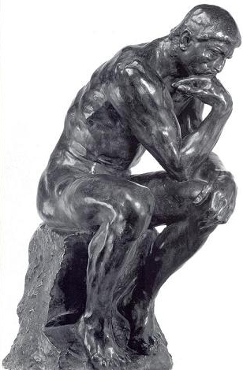
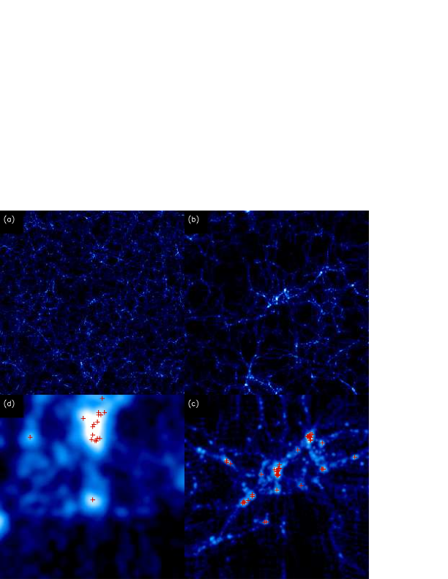
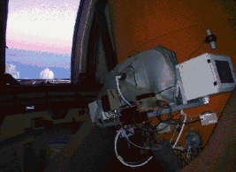
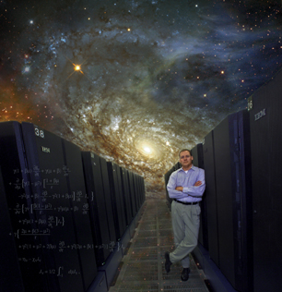
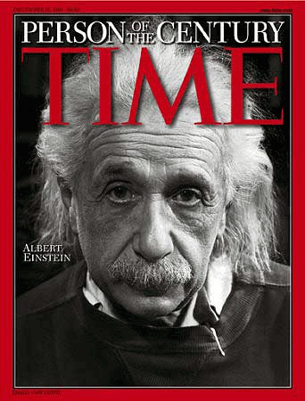
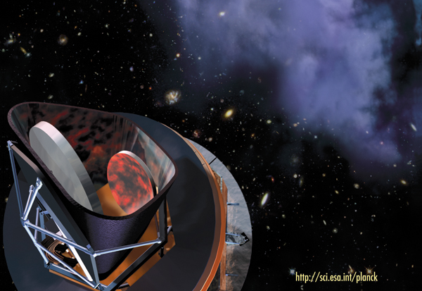
How Do We Learn about the Universe?
Observation
Theory
Computation

Slide 3


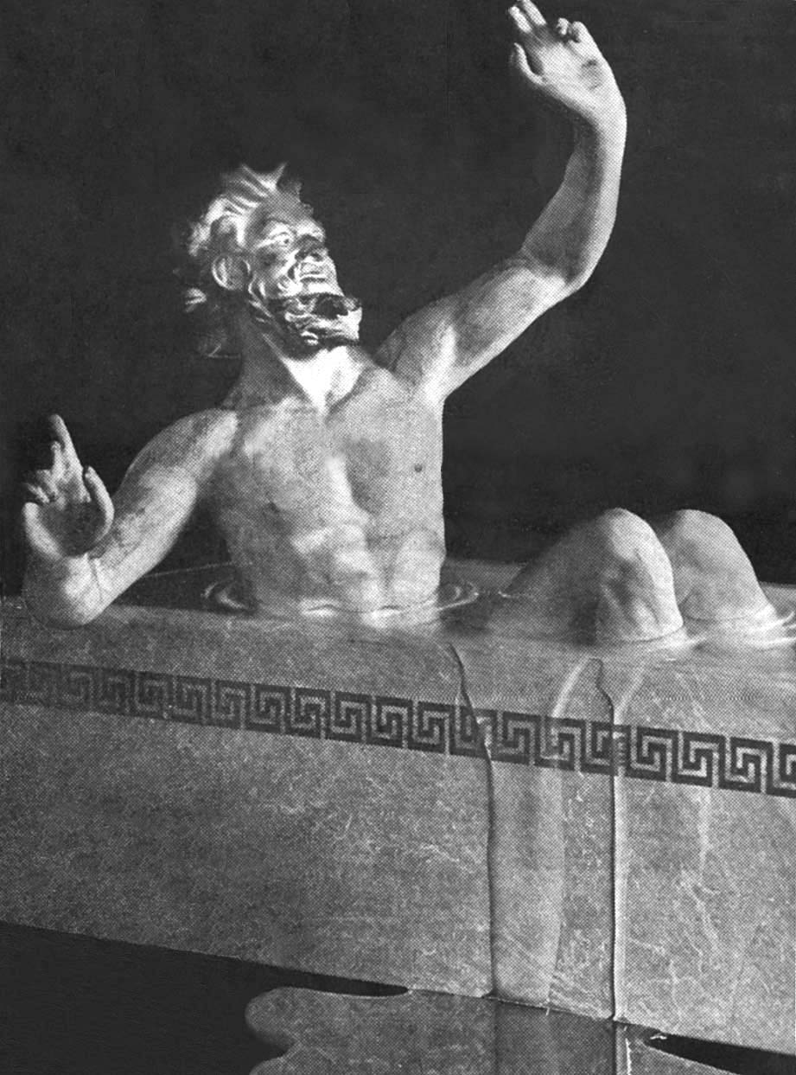
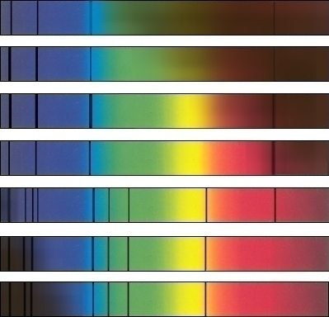
Eureka!
1835: “We shall never be able to know the composition of stars” – Comte
1849: Kirchhoff discovers that the spectrum of electromagnetic radiation encodes the composition

Slide 4
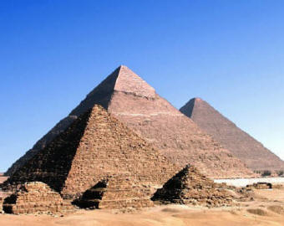
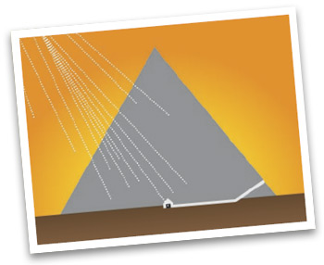
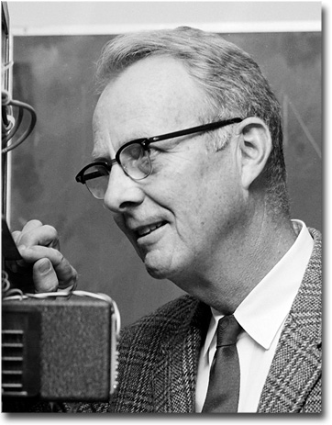
Eureka!
1968: Nobel Prize in Physics to Luis Alvarez (Berkeley)

Slide 5

Astronomy is a Time Machine
Looking out in space is looking back in time.
Imagine you get postcards from a traveling friend. You don’t know how they are now, but how they were.
The weather’s great.
Wish you were here now!
Astronomers
Earth
Milky Way Galaxy
Since the speed of light is not infinite, the more distant an object, the more we see the universe as it was long ago. Looking out is looking back.

Slide 6

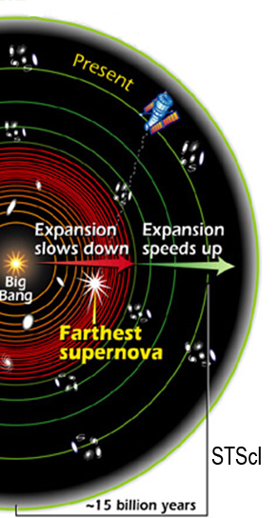
Mapping Our History
We can learn about the cosmic history even though we can’t touch the stars.
Light brings messages from the distant past.

Slide 7
Mapping Our History
Like tree rings mapping out the climate history of Earth,
cosmic distances expand with time,
slowing down and speeding up,
mapping out cosmic history.

Slide 8
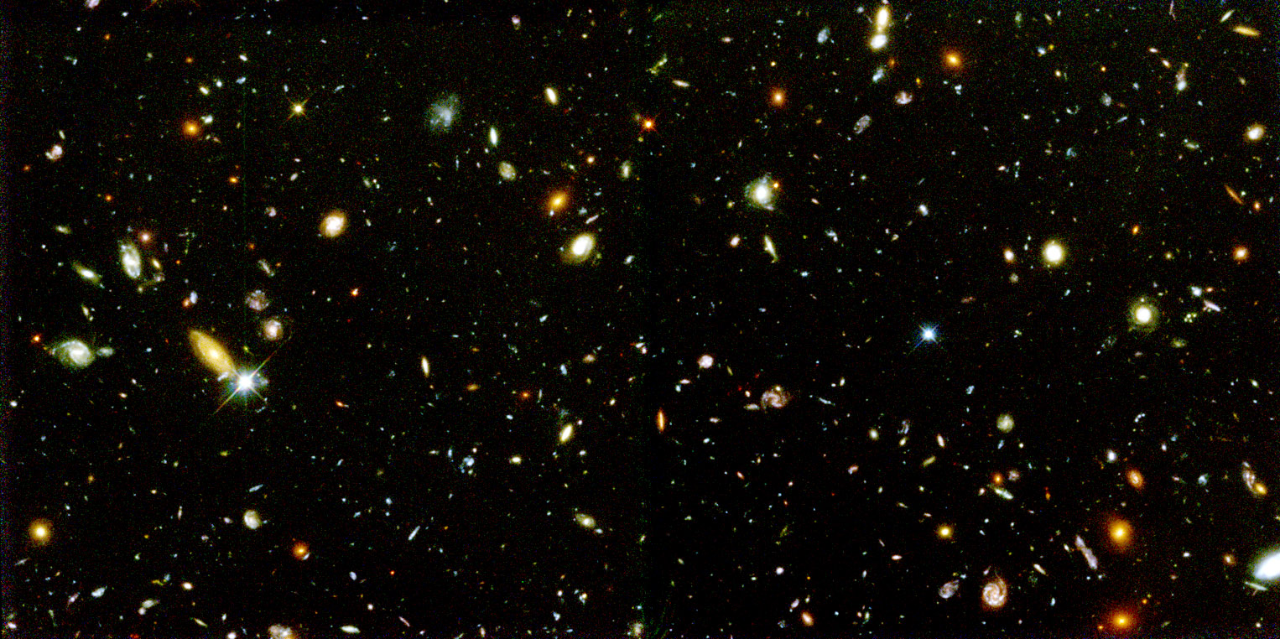
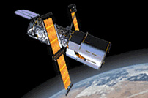
Looking Back 10 Billion Years
STScI

Slide 9
Equivalence Principle and Cosmology
Einstein’s Equivalence Principle:
Gravity = Curvature = Acceleration
Gravity is equivalent to the curvature of spacetime geometry, and determines the motions of particles along geodesics.
Forces (acceleration) change the motions of particles can be viewed as affecting spacetime geometry. Locally, acceleration is equivalent to gravity.

Slide 10
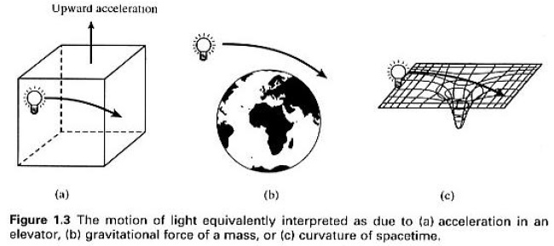
Equivalence Principle

Slide 11
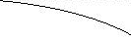
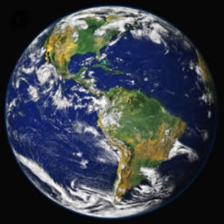
Acceleration = Gravity
*
*
In the presence of gravity or of acceleration, light follows a curved path. Locally, they are equivalent.

Slide 12
Acceleration = Curvature
The Principle of Equivalence teaches that
Acceleration = Gravity = Curvature
Height
t´
t₀
Time
Acceleration ⇒ over time will get v=gh/c, so z = v/c = gh/c² (gravitational redshift).
But, t′≠t₀ ⇒ parallel lines not parallel (curvature)!

Slide 13
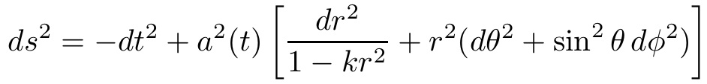
Spacetime Geometry
Therefore we describe cosmology in a spacetime with curvature. (This is separate from whether space has curvature.)
Homogeneity and isotropy determine the space to be maximally symmetric and the metric takes the Robertson-Walker form.
The key ingredients are
constant parameter k – spatial curvature,
function of time a(t) – scale (expansion) factor.

Slide 14


Cosmic Expansion and Acceleration
Space flatness: k=0
Spacetime flatness: = 0
All results coming directly from the metric (spacetime symmetries) are called kinematics.
We have not had to specify any laws of gravity!
(Results requiring force laws are called dynamics.)
The metric can be spatially flat (k=0) but the spacetime is curved if
This is exactly the Equivalence Principle: Gravity = Curvature = Acceleration

Slide 15
Cosmological Framework
Equivalence Principle
Metric description of spacetime
Homogeneity and Isotropy
Metric is Robertson-Walker (a,k)
Energy-momentum has perfect fluid form (ρ,p)
Gravitational Field Eqs (General Relativity) + Homogeneity and Isotropy
Friedmann equations for evolution of spacetime
Equations of State + Friedmann equations
→ Evolution of energy densities

Slide 16
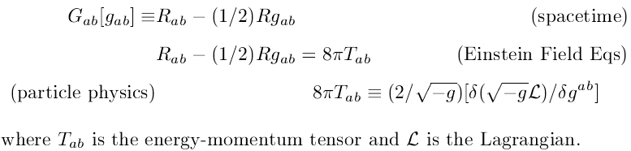
1 Minute General Relativity
General relativity:
“Time and space and gravity have no separate existence from matter” – Albert Einstein
“Matter tells geometry how to curve, and geometry tells matter how to move” – John Wheeler
It can be developed through 1) Coordinate invariance and tensors, 2) Field theory of spin 2 fields, 3) Differential geometry.

Slide 17
Gravitating Energy
Einstein says gravitating mass depends on energy-momentum tensor: both energy density ρ and pressure p, as ρ+3p
Negative pressure can give negative “mass”
Newton’s 2nd law: Acceleration = Force / mass
R = -GM/R² = - (4π/3)G ρ R
Einstein/Friedmann equation:
a = - (4π/3)G (ρ+3p) a
Negative pressure can accelerate the expansion
..
..

Slide 18
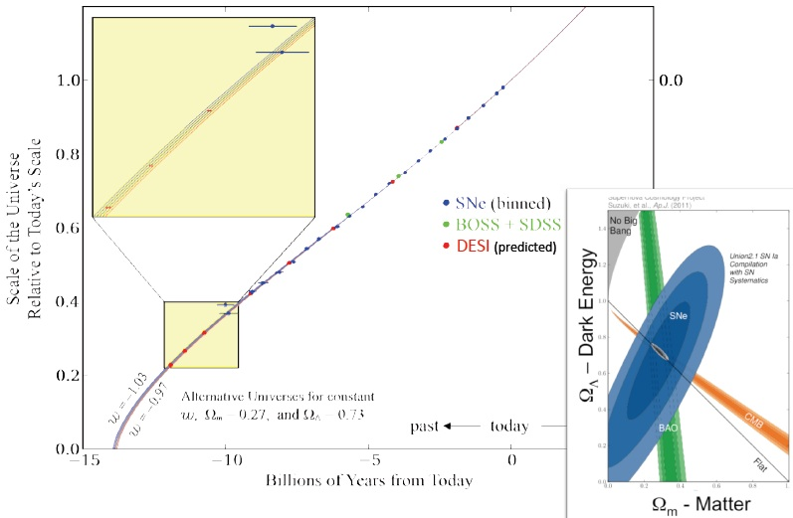
Expansion History
Distances come directly from the metric. Measuring them through, e.g., Type Ia supernovae, maps the expansion history a(t) and hence acceleration.

Slide 19
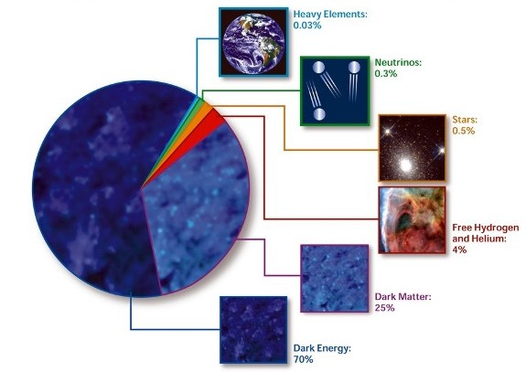
Describing Our Universe
Us
New Stuff
Old New Stuff
Us
STScI
95% of the universe is unknown!

Slide 20
Role of Theory
Cosmic acceleration and dark energy are fundamental mysteries in understanding our universe.
Copernican Principle / Cosmic Modesty:
Our galaxy is not the center of the universe.
Our particles are not the matter/energy of the universe.
Is our vacuum the vacuum of the universe?
Is our gravity the gravity of the universe?

Slide 21
Finding Our Way in the Dark
Dark energy is a completely unknown animal.
A new theory or a new component?
Track record:
Outer solar system motions → Neptune
Inner solar system motions → General Relativity
Galaxy rotation curves → Dark Matter

Slide 22
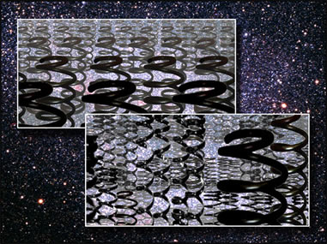
Nature of Acceleration
Is dark energy static? Einstein’s cosmological constant Λ.
Is dark energy dynamic? A new, time- and space-varying field.
How do we learn what it is, not just that it is?
Is dark energy a change in gravity?
How much dark energy is there? Ω_{DE}
How springy/stretchy is it? w=P/ρ
A new law of gravity, or a new component? G_{N}(k,z)

Slide 23


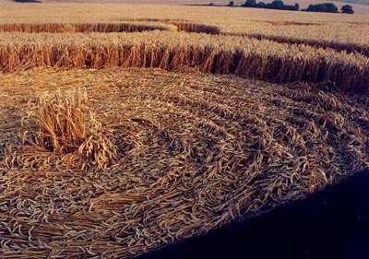
Theory of Fields
Scalar field:
Vector field:
At every point in a trampled field of grass, you can measure the length of the grass and the direction it is lying: a vector g(x).
At every point in a field of grass, you can measure the height of the grass: a single number or scalar h(x).
→

Slide 24
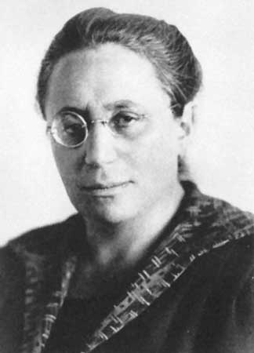
Scalar Field Theory
Scalar field Lagrangian -
canonical, minimally coupled
L_{φ} = (1/2)(∂_{μ}φ)² - V(φ)
Noether prescription → Energy-momentum tensor
T_{μν}=(2/√-g) [ δ(√-g L )/δg_{μν} ]
Perfect fluid form (from RW metric)
.
Energy density ρ_{φ} = (1/2) φ ² + V(φ) + (1/2)(∇φ)²
Pressure p_{φ} = (1/2) φ ² - V(φ) - (1/6)(∇φ)²
.
+ (1/2)(∇φ)²

Slide 25
Scalar Field Equation of State
Equation of state ratio
w = p/ρ
Klein-Gordon equation (Lagrange equation of motion)
¨
˙
φ + 3Hφ = -dV(φ)/dφ
Continuity equation follows KG equation
[(1/2)φ ²] + 6H [(1/2)φ ² ] = -V
ρ - V + 3H (ρ+p) = -V
dρ/dln a = -3(ρ+p) = -3ρ (1+w)
.
.
.
.
.
.
.

Slide 26
Equation of State
Limits of (canonical) Equations of State:
w = (K-V) / (K+V)
Potential energy dominates (slow roll)
V >> K ⇒ w = -1
Kinetic energy dominates (fast roll)
K >> V ⇒ w = +1
Oscillation about potential minimum (or coherent field, e.g. axion)
⟨V⟩ = ⟨K⟩ ⇒ w = 0

Slide 27
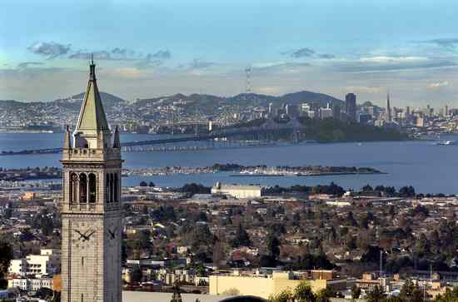




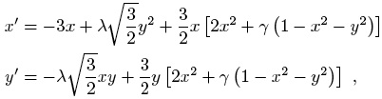
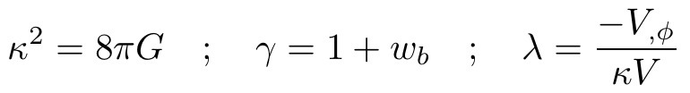
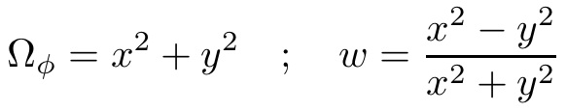
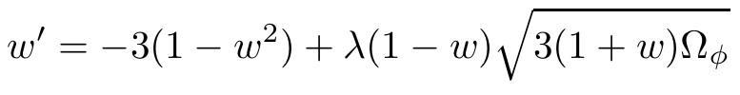
Solving the Equation of Motion
Klein-Gordon equation
Transform to new variables
Autonomous system
Copeland, Liddle, Wands 1998 Phys. Rev. D 57, 4686
where
Transform solution to
Can add equation for EOS dynamics
Caldwell & Linder 2005 Phys. Rev. Lett 95, 141301

Slide 28
Expansion History
Observations that map out expansion history a(t), or w(a), tell us about the fundamental physics of dark energy.
Alterations to Friedmann framework → w(a)
Suppose we admit our ignorance:
H² = (8π/3) ρ_{m} + δH²(a)
Effective equation of state:
w(a) = -1 - (1/3) dln (δH²) / dln a
Modifications of the expansion history are equivalent to time variation w(a). Period.
gravitational extensions or high energy physics

Slide 29
Physics of Growth
Growth g(a)=(δρ/ρ)/a depends purely on the expansion history H(z) – and gravity theory.
0
Within general relativity (G=G_{N}=1), expansion determines growth and vice versa.
Acceleration suppresses growth in two ways:
1) the friction term ~ (3-q) so q<0 slows growth,
2) the source term Ω_{m}(a) is diminished.

Slide 30
The Direction of Gravity
Cosmic acceleration: Gravity is pulling out not down!
Is gravity (G_{Newton}) constant, or strengthening, or weakening with time?
Does gravity govern the growth of large scale structure exactly as it does for cosmic expansion, or are there more degrees of freedom?
Effect of gravity on light (strong/weak lensing).
Does gravity behave the same on all scales?
Dark energy motivates us to ask “what happens when gravity no longer points down?”.

Slide 31

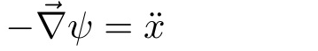
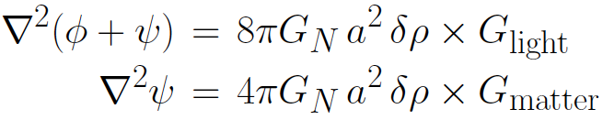
Testing Gravity
Test gravity in model independent way.
Gravity and growth: Gravity and acceleration:
Are φ and ψ the same? (yes, in GR)
Tie to observations via modified Poisson equations:
G_{light} tests how light responds to gravity: central to lensing and integrated Sachs-Wolfe.
G_{matter} tests how matter responds to gravity: central to growth and velocities (γ is closely related).
cf Bertschinger & Zukin 2008

Slide 32
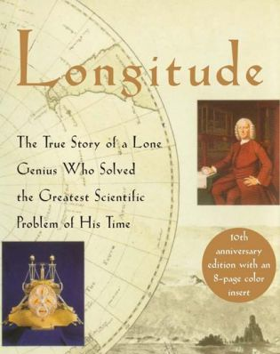
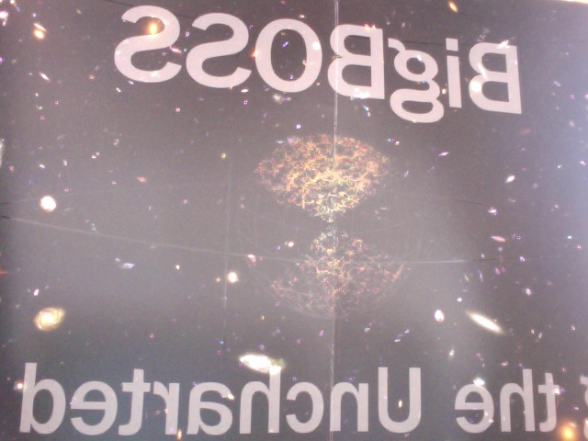
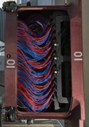
“Greatest Scientific Problem”
Redshift

Slide 33
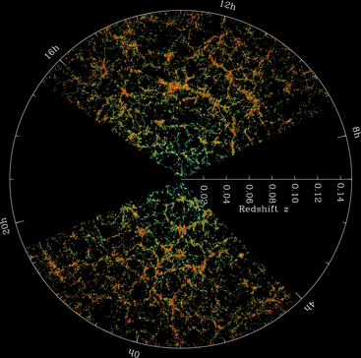
Cosmic Structure
Galaxy 3D distribution or power spectrum contains information on:
Growth - evolving amplitude
Matter/radiation density, H - peak turnover
Distances - baryon acoustic oscillations
Growth rate - redshift space distortions
Neutrino mass, non-Gaussianity, gravity, etc.
x25 (x7 LRG)
...

Slide 34
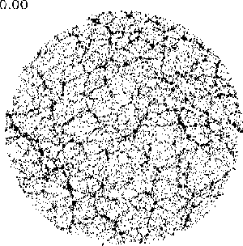
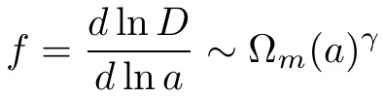
Redshift Space Distortions
Redshift space distortions (RSD) map velocity field along line of sight. Gets at growth rate f, one less integral than growth factor (like H vs d).
Ω_{m} =
Linder 2005
gravitational growth index γ
Hume Feldman

Slide 35

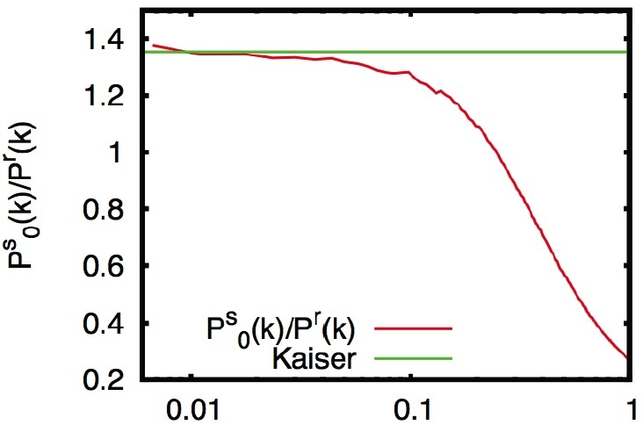
Beyond Linear
Kaiser formula inaccurate
Even monopole (average over RSD) is poor.
Anisotropic redshift distortion hopeless – without better theory.
k (h/Mpc)
Major approaches are high order perturbation theory, computational simulations – or a new combination of the two.
ECL Opportunity – Theoretical and computational expertise – RSD, gravity/growth

Slide 36
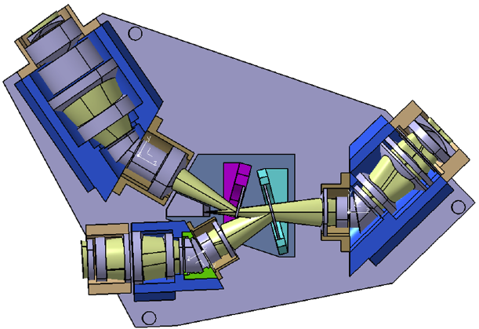
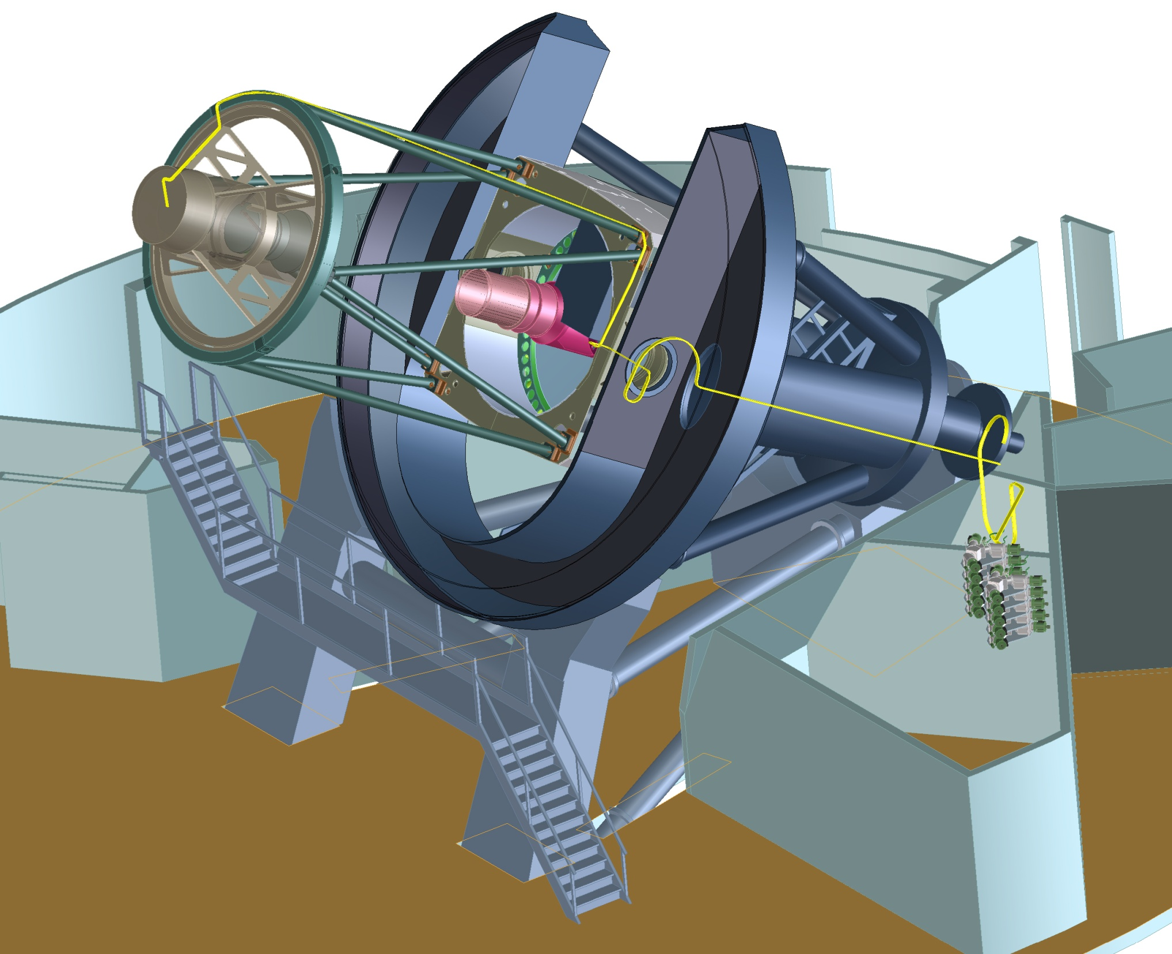
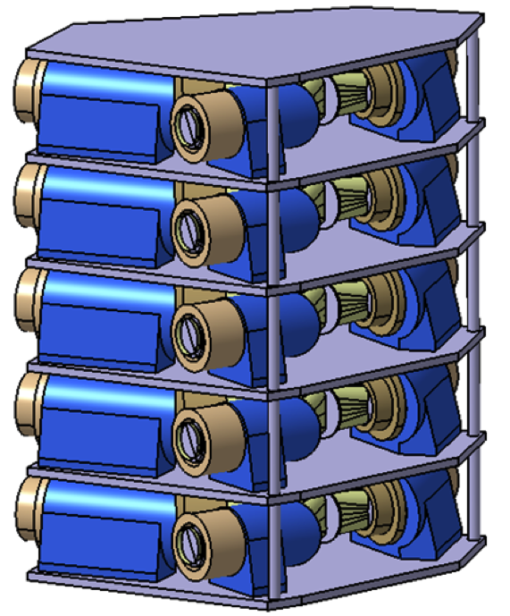
DESI (Dark Energy Spectroscopic Instrument)
• 50 (Gpc/h)³ volume, z=0.2-3 (galaxy + Lyα)
• 30 million spectra, 5000 robotic fiber positioners
• 3 degree field
ECL Opportunity – Next generation robotic fiber positioning
M. Sholl+

Slide 37
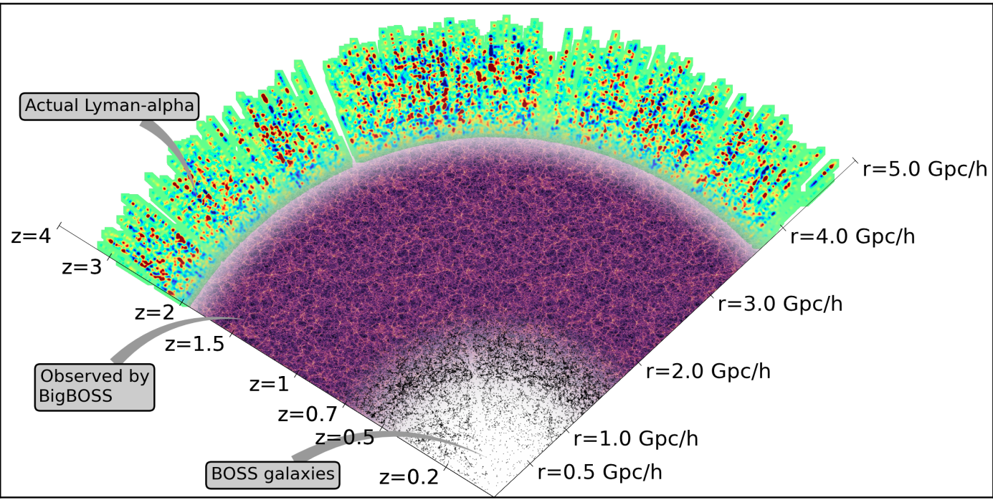
Dark Energy Spectroscopic Instrument
DESI
3D map of 50 (Gpc/h)³ volume with 6M Luminous Red Galaxies, 22 M Emission Line Galaxies, 2M Quasars Tomographic surveys of density/velocity field.
Notes:
Cosmology is growing in new, sophisticated directions, and data interpretation, synthesis, and visualization will play key roles and deliver unprecedented opportunities to understand the universe and fundamental physics.

Slide 38
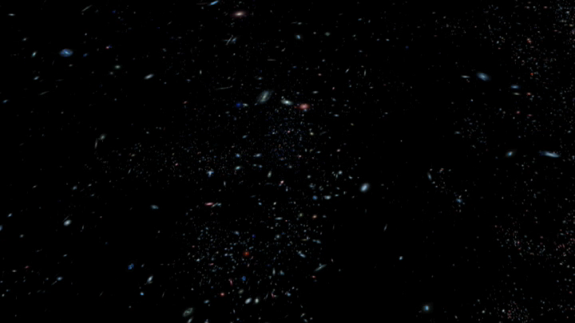
Our Actual Universe
SDSS DR4 movie
http://video.google.com/videoplay?docid=-8252705102362324792&q=sdss

Slide 39
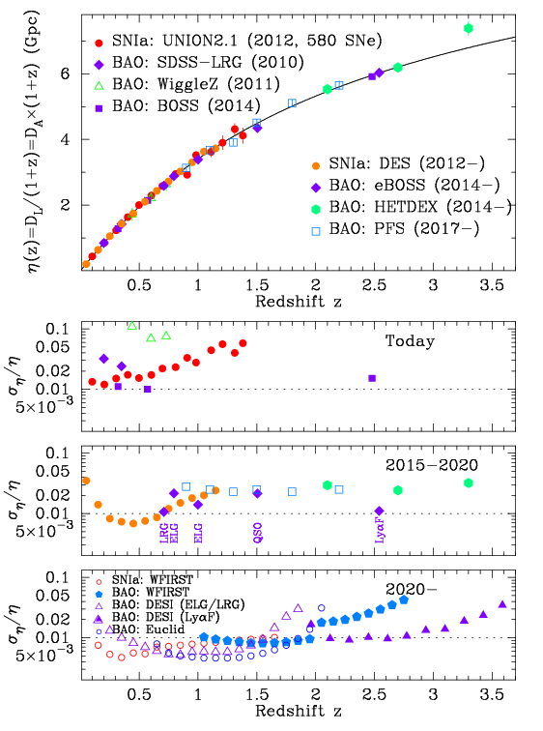
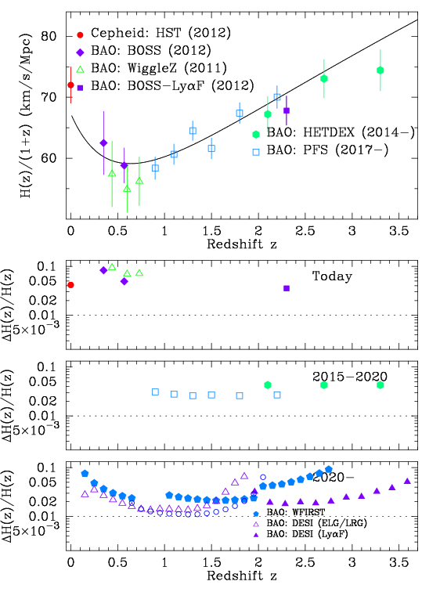
Progress in Distances
1309.5382

Slide 40
Mapping Our History
We can learn about the cosmic history even though we can’t touch the stars.
Light brings messages from the distant past.

Slide 41

The Big Bang
We observe the universe to be expanding, and we observe the glow left from the hot early universe.
The universe used to be much smaller, hotter, and denser (more energy in a smaller space).
Expansion from this state is known as the Big Bang.

Slide 42
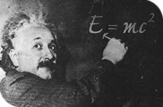
In the Beginning…
Conditions were very different in the early universe.
Let’s trace the cosmic history all the way from the beginning.
It all starts with E=mc².

Slide 43
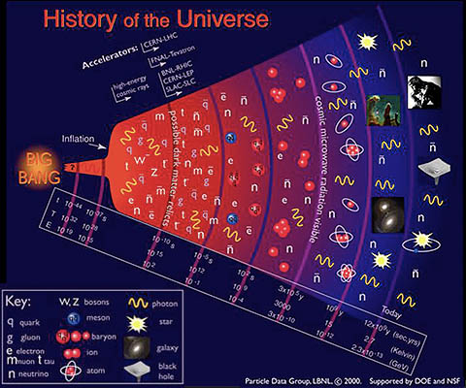
The Early Universe
Remember that the early universe was very hot (energetic) and dense.
Since E=mc², then…
With lots of energy, lots of particles (matter and radiation) can be created. (Think E → mc²)
When there are many particles per volume (dense), the particles can interact and return to being energy (annihilate). (Think mc² → E)

Slide 44
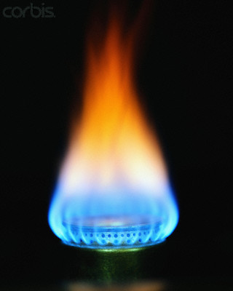
Relic of Creation
The glow we detect everywhere in the sky is the remnant glow of the early hot universe.
Today it has cooled to only 3 degrees above absolute zero, 3 K. The photons have diminished so much in energy that they are in the microwave region of the spectrum.

Slide 45

Cosmic Background Radiation
What does it look like?
The glow we detect everywhere in the sky is the remnant glow of the early hot universe.

Slide 46
Cosmic Background Radiation
Why does it look so unexciting?
Because it is everywhere the same temperature. The early universe was so hot and dense, it was in thermal equilibrium.

Slide 47

The Earliest Structure
Is the temperature then perfectly uniform?
No! In 1992 the COBE satellite discovered tiny temperature variations of 0.001%.

Slide 48

Relic of Creation
These very faint hotter and colder spots came from the patches of less dense and more dense energy in the early universe (when particles were created at the end of inflation).
They also show the seeds of matter structures that grew into galaxies and clusters of galaxies.
George Smoot and John Mather won the 2006 Nobel Prize in Physics for the discovery of these temperature variations.

Slide 49




Power Spectrum
To learn physics from a map of the temperature T(t) we want to know its mean T=2.73 K, and its variation as a function of scale.
The angular power spectrum is
We can also Fourier transform it to multipole space
or wavenumber space
CMB temperature variations are related to matter density variations; the density power spectrum is

Slide 50



Baryon Acoustic Oscillations
In the beginning... Photons tightly coupled with baryons. Density perturbations in one would cause perturbations in the other, but they couldn’t grow - merely oscillated on scales set by the sound horizon. Then swift decoupling so the perturbations were preserved.
Baryon acoustic oscillations = patterned distribution of galaxies on very large scales (~150 Mpc).
M. White
(CMB)
The same primordial imprints in the photon field show up in matter density fluctuations.
Angular separation → angular distance d(z) Radial distance in z → expansion rate H(z)

Slide 51

Cosmic Background Radiation
The cosmic microwave background radiation (CMB) tells us that the early universe was very hot and dense - in thermal equilibrium.
But the CMB also gives us clues to the source of all structure in the universe, tiny variations generated in the first fraction of a second by inflation – cosmic acceleration just after the Big Bang.

Slide 52



What do we see in the CMB?
COBE
WMAP
Planck
A view of the universe 99.997% of the way back toward the Big Bang - and much more.

Slide 53

Mapping the Universe
Remember, this is a picture of the whole universe the way it was 380,000 years after the Big Bang!

Slide 54

Think About
Exercise 1: Since the scale factor changes with time, a(t), the expansion rate H also changes with time. Show that the sign of redshift drift dz/dt₀=d[a(t₀)/a(t_{e})]/dt₀ gives the sign of acceleration (and write in terms of H).
Exercise 2: Show that = 0 is equivalent to a flat (Minkowski) spacetime. [Not as easy as it may look!]
Exercise 3: Solve the dynamics for a DBI scalar field
Exercise 4: Put a fundamental scale in the Friedmann equation for H(a), say as a power law δH²=(H/r_{c})^{n}. What is w(a) and the early/late time behavior?

Slide 55
Further Reading
For more cosmic acceleration resources, see
http://supernova.lbl.gov/~evlinder/scires.html
Resource Letter on Dark Energy http://arxiv.org/abs/0705.4102
Mapping the Cosmological Expansion http://arxiv.org/abs/0801.2968
Frieman, Turner, Huterer 2008, Dark Energy and the Accelerating Universe http://arxiv.org/abs/0803.0982
and the references cited therein.
For resources on dark energy as a field, see
Copeland, Sami, Tsujikawa 2006, Dynamics of Dark Energy http://arxiv.org/abs/hep-th/0603057 and the references cited therein.
For resources on dark energy as gravity, see
Jain & Khoury 2010, Cosmological Tests of Gravity http://arxiv.org/abs/1004.3294 and the references cited therein.

Slide 56
Further Reading
For more resources on dark cosmology and its future, see
Euclid Theory Group 2012, Cosmology and Fundamental Physics with the Euclid Satellite http://arxiv.org/abs/1206.1225
Snowmass CF5, Distance Probes of Dark Energy http://arxiv.org/abs/1309.5382
Snowmass CF5, Growth of Cosmic Structure: Probing Dark Energy beyond Expansion http://arxiv.org/abs/1309.5385
Snowmass CF5, Neutrino Physics from the Cosmic Microwave Background and Large Scale Structure http://arxiv.org/abs/1309.5383
Snowmass CF5, Inflation Physics from the Cosmic Microwave Background and Large Scale Structure http://arxiv.org/abs/1309.5381
Snowmass CF5, Facilities for Dark Energy Investigations http://arxiv.org/abs/1309.5380

